Slide 1
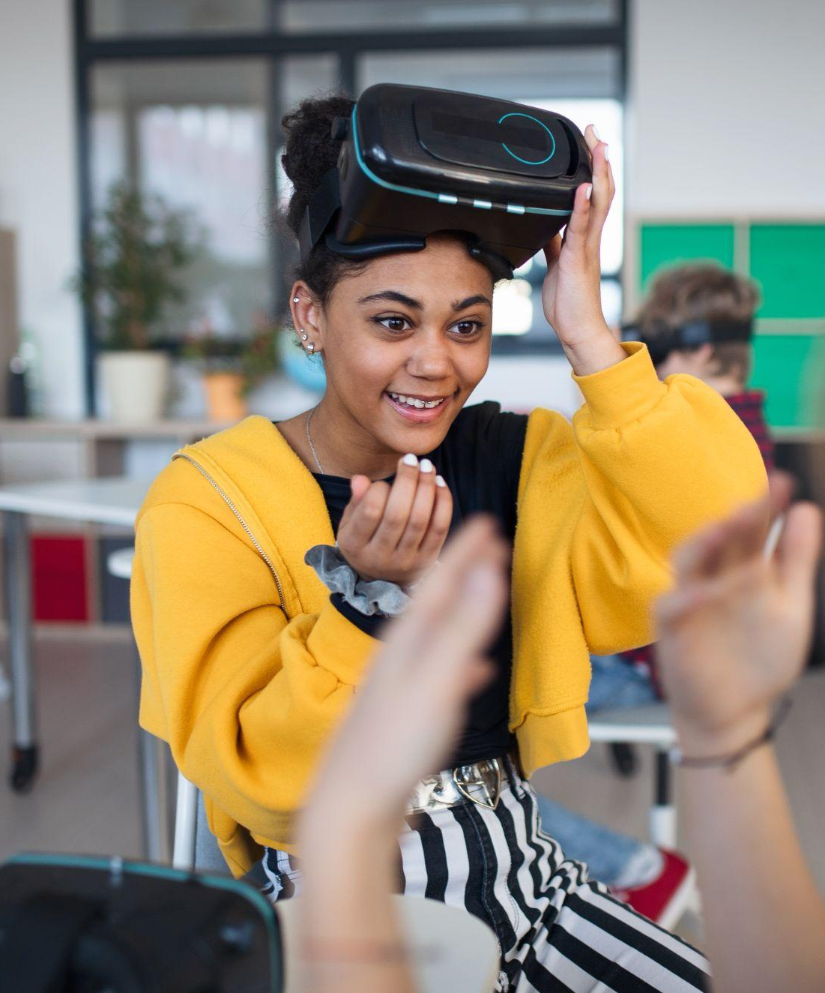

Dora Kitching - Development Assistant
d.kitching@in2scienceuk.org

Slide 2


Who are we?
In2scienceUK is a social mobility charity dedicated to helping young people from low-income backgrounds all over the UK gain access to STEM degrees and careers
This boosts diversity and inclusion in the UK STEM sector
How do we do this?
In2scienceUK delivers various programmes to young people of different age groups, providing high-quality opportunities such as:
Placements
Workshops
Mentoring

Slide 3
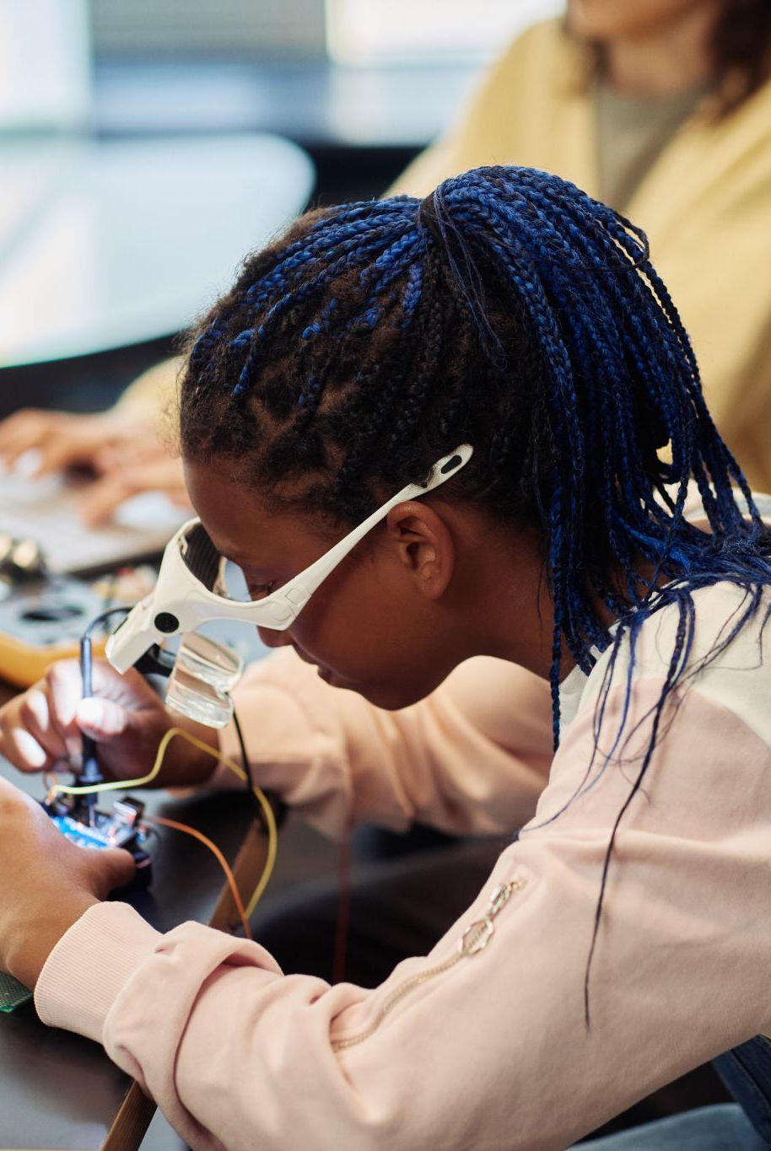
Why are we needed?
People from low-income backgrounds remain significantly underrepresented in STEM:
Only 6% of doctors, 9% of life science professionals and 19% of IT professionals were from low-socioeconomic backgrounds in 2022
1 in 3 students from low-income households progress to university, compared to 1 in 2 of their peers
There is economic inequality - UK STEM graduates can earn nearly 20% more than their peers
Lack of STEM networks and knowledge of careers - Only 57% of teachers report that their schools engage with STEM employers annually

Slide 4
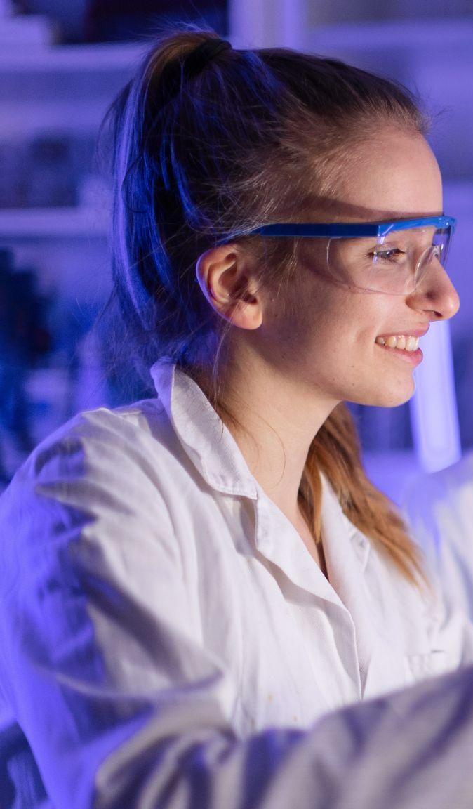
Our mission
Young people from low-income backgrounds face unique challenges to realising their ambitions to become STEM professionals:
Low exposure to relatable, aspirational role models.
Poor access to financial and human capital.
Poor access to academic and career-development services.
Economic, racial and gender discrimination.
in2scienceUK breaks down these systemic barriers and widens access to STEM so that young people can progress to vibrant STEM careers and education regardless of their background:
Practical and employability skills
Knowledge of STEM pathways and careers
Confidence

Slide 5
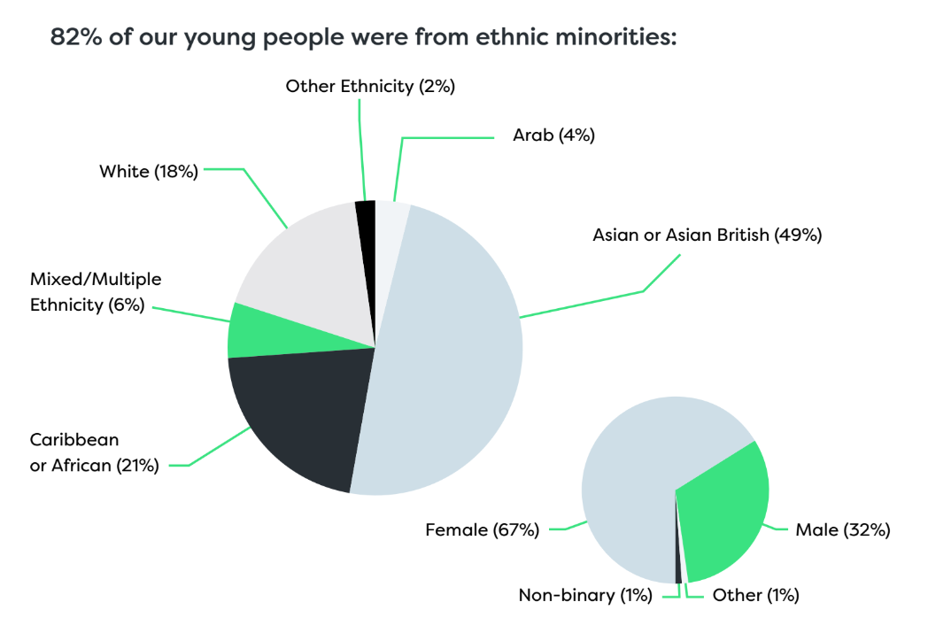
Our participants
All In2scienceUK participants come from low-income backgrounds.
To be eligible for our programmes, students must meet one or more of the following criteria:
Eligible for free school meals
Have parents who do not have university degrees
Received Pupil Premium, Education Maintenance Allowance (EMA) or the 16-19 Bursary
Have care experience or caring responsibilities
Have an education healthcare plan
*Data based on 2024 In2STEM cohort.

Slide 6
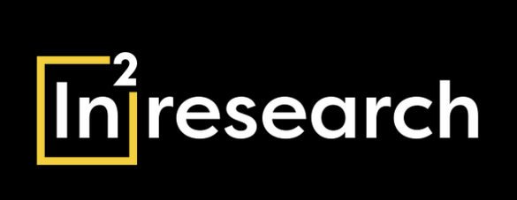


Our programmes

Slide 7
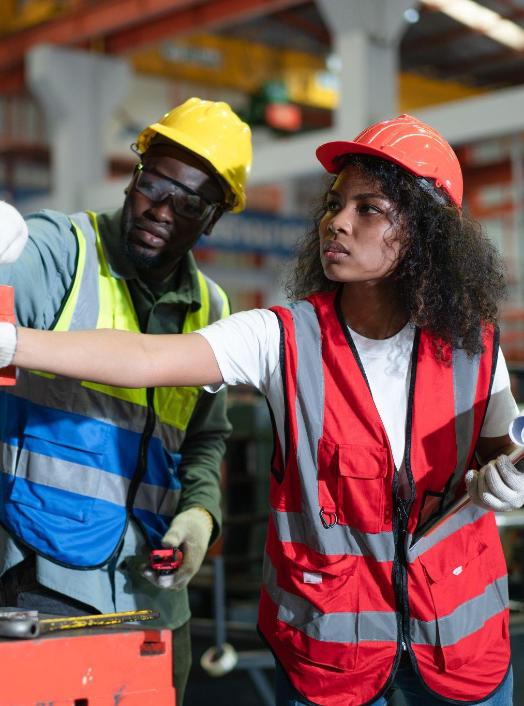
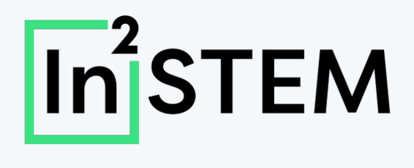
The In2STEM Programme is a two-month long programme for 16-19 year olds that takes place in the summer of each year.
Opportunities include:
A one- to two-week in-person placement
Skills and employability workshops
Online careers panels
Public engagement competitions

Slide 8
How can you support ?
Host a placement: Share your insight and expertise with young people by hosting a 1-2 week summer work experience placement in 2025:
No prior experience needed - apply as an individual or co-host with colleagues!
Applications are open NOW. To find out more, visit our website or sign up to a free information session.
Take part in a workshop or careers panel: Share your skills or career stories in an online webinar next summer. Contact hosts@in2scienceuk.org with your ideas!
Help fund In2STEM: We rely on external funding to deliver our programmes. Donate today or sponsor participants - your funding can be specifically allocated to support young people interested in your field/from your location!

Slide 9
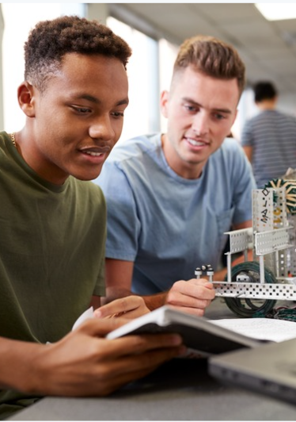

In2research is a year-long programme designed to enhance access to postgraduate research degrees and career opportunities.
This includes:
A full-time 8-week summer research placements at a top university supported by a tax-free stipend exceeding £3,000
Online workshops
Mentoring sessions with a subject-specific researcher
In-person away days in London
We are piloting In2research for the first time in Glasgow this year!

Slide 10
How can you support ?
Currently, there are no open volunteer opportunities for our 2024/25 In2research programme. However, if you are interested in getting involved in future years, you can express your interest on our website now to:
Host a research placement: If you are located in Glasgow, register your interest now to be a host in 2025/26!
Mentor: Hold four one-hour online mentoring sessions with one or two mentees. Provide subject-specific guidance and insight into your experience of working in research
You can also help fund In2research by donating today or sponsoring participants!

Slide 11


In2careers is our new digital platform where In2scienceUK alumni can connect and benefit from ongoing career-development support that extends beyond the timeline of our programmes.
Our 2,200+ users benefit from:
Workshops delivered by STEM experts
Exclusive access to event tickets
Peer and industry mentoring
Networking opportunities
Site visits
Careers panel sessions
Job and apprenticeship opportunities
…and much more!

Slide 12
How can you support ?
In2careers supports young people all year round. This means our volunteer opportunities are flexible and can fit around your daily schedule!
Be a mentor: Provide guidance and support to a young person interested in your expertise.
Host an online workshop or careers panel: Share your knowledge or your career journey to young people all over the UK.
Share resources or upcoming opportunities: If you have job openings, event tickets, site visits, or exciting activities or resources that you think would benefit our users, share them with us!
Contact careers@in2scienceuk.org if you have any questions or ideas!

Slide 13
Our impact

Slide 14
Our impact
To date the In2STEM programme has supported 5350 participants.
In 2024, we received 2036 applications for our In2STEM programme, and we supported 851 participants.
Participants reported:
Increased confidence in their abilities - 87% stated that they now felt confident introducing themselves to a researcher or STEM professional in person or by email (up from 63% pre-programme)
Improved knowledge about STEM - 85% agreed that they understand the content and structure of a range of STEM degrees and apprenticeships, up from 53%
New skills and experience acquisition - 67% of participants stated post-programme that they have drafted a personal statement for their UCAS application, a huge increase from 21%

Slide 15

Our impact continued…
96% of In2research programme participants stating that the programme improved their confidence in applying to and undertaking a PhD
70% agreed/strongly agreed that they now have confidence in their ability to develop a PhD application, a huge increase from 3% pre-programme
Crucially, 83% of all In2STEM and In2research programme alumni in full-time employment are working in a STEM field
*Data based on 2023 cohorts.

Slide 16
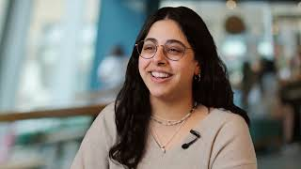
Hear from our participants…

Slide 17
Thank you for your time!
Together, we can support disadvantaged young people to achieve success in STEM
Any questions?

Slide 18
Helpful links:
About our programmes:
In2STEM https://in2scienceuk.org/our-programmes/in2stem/
In2research https://in2scienceuk.org/our-programmes/in2research/
In2careers https://in2scienceuk.org/our-programmes/in2careers/
Our impact reports https://in2scienceuk.org/impact/
Volunteer information:
General https://in2scienceuk.org/volunteer/
In2STEM
FAQs for hosting a placement https://in2scienceuk.org/volunteers-in2stem/
Register for one of our info sessions https://in2scienceuk.org/volunteers-in2stem/programme-information/
Application form https://in2scienceuk.org/volunteers-in2stem/host-apply/
In2research
Expression of interest form https://survey.alchemer.eu/s3/90714379/2025-26-In2research-volunteer-expression-of-interest-form
In2careers
More information https://in2scienceuk.org/in2careers-volunteers/

